Slide 1
Small FLICS to Big Flips
A step by step guide to flipping your classroom
Patrick Kelly & Isabelle Barrette-Ng

Slide 2
Outcomes
Conceptualize what flipped learning looks like
Determine a starting point to flipping your classroom
Create a flipped lesson
Explore some of the technology available and apply to your flipped lesson
Evaluate your flipped lesson

Slide 3
Agenda
Day 1
Introduce FLICS
Practice creating a flipped lesson
Begin your own flipped lesson
Explore some of the technology

Slide 4
Agenda
Homework for Day 2
Create flipped lesson plan
Create or find a short podcast/video/simulation to support your lesson
Day 2
Present lesson plan to small groups and provide feedback
Student assessment
Flipped road blocks & strategies

Slide 5
Norms
Notes:
We will be discussing and sharing ideas in large and small groups. Part of learning is learning from our own experiences and from others. We want to create a space where we can share these ideas.
What would help you feel comfortable doing so?

Slide 6
Definition
Flipped Learning is a pedagogical framework to facilitate meaningful student learning experiences using active learning strategies. A Flipped classroom has online interactive instruction, content exploration and student collaboration, while the classroom space is transformed into a interactive learning environment where the students work together and with the instructor to apply their knowledge and test their assumptions.
Adapted from Flipped Learning Network, http://www.flippedlearning.org/domain/46

Slide 7
Survey Results
Share results
Notes:
Record on whiteboard

Slide 8
Your students
The prepared, who don’t see the point in attending the workshop and don’t come
The prepared who come to the workshop annoyed at having to seemingly do more work
Prepared who come to the workshop ready to engage and learn
Underprepared who tried but didn’t understand the content and come frustrated and an/or anxious of underperformance in class
Underprepared who didn’t try and come to learn what you expected them to learn in advance
Underprepared who did not come
Notes:
Who are you
Stand at your whiteboard
Discuss reasons for your selection.
What are some strategies for instructors to work with a mix of students?

Slide 9
What is FLICS?
Flipped Learning-Centered Interactive Classroom Strategy
A sequential model to plan and create microflips or a flipped classroom

Slide 10
Literature Review
Content becomes more easily accessed and controlled by the student (Gerstein, 2012; Moffett, 2014)
Evidence that flipped learning as a positive impact on student learning (Tune, Sturek, and Basile, 2013; Herreid & Schiller, 2013; Gilboy, Heinerichs, Pazzaglia, 2014)
Start small by selecting one lesson (Steed, 2012)
Facilitates mastery learning (Bergmann & Sams, 2012)
Students become more open to cooperative and innovative teaching strategies (Strayer, 2010)
Notes:
Not a MOOC

Slide 11
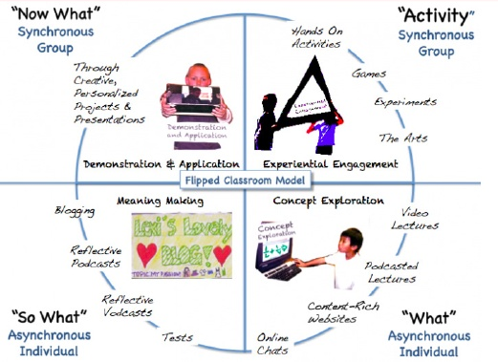
Gerstein, J. Retrieved from http://usergeneratededucation.wordpress.com/2012/05/15/flipped-classroom-the-full-picture-for-higher-education/

Slide 12
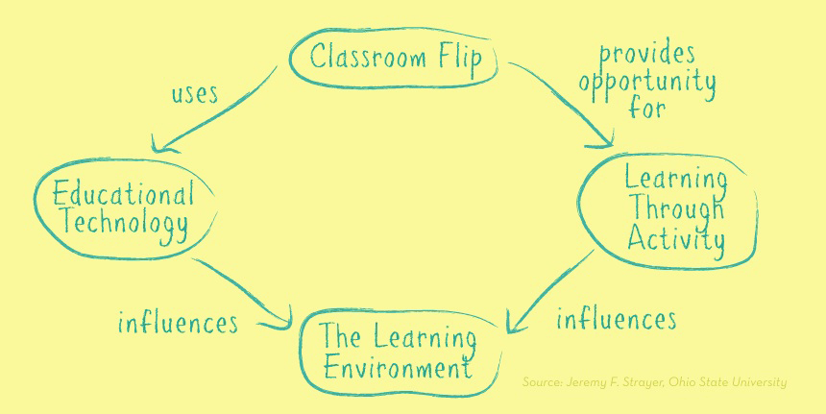
Strayer, J. (2011). The flipped classroom. Retrieved from http://www.knewton.com/flipped-classroom/

Slide 13
7 principles of effective teaching and learning
Encourages interaction between students and faculty
Encourages interaction between students
Utilizes active learning strategies
Provides prompt and useful feedback
Emphasizes time on task
Sets high expectations
Respects diversity and ways of learning
Notes:
Have both online and classroom opportunities for students to ask questions, office time, provide feedback
Plan collaborative activities in the classroom and online. Focus the intensive collaborative activities for the classroom
Keep students active both online and in the classroom. Remember that active can be accomplished with individual learning
Use D2L tools to provide immediate feedback such as quizzes. Make sure students leave the classroom with feedback or provide it before next class
Time is spent working on the problems. Make sure instructions are clear to students so they do not spend time off task
Set standards for students completing online work before class and have high expectations of students work and collaboration in class
Online resources can naturally be diverse in the way the material is presented and sourced. Using online activities and in classroom can account for a variety of student abilities.

Slide 14
Initial Thoughts?
What are your initial thoughts about flipped learning?
Concerns
Benefits
Questions

Slide 15
FLOW
Notes:
When using flipped strategies, it is important to remember the course needs to have flow. Much like a river, everything is connected and the water flow around rocks or the banks.

Slide 16
Traditional Class
Read
Out of Class
Try Things
Group
work
Content
Application
Engagement
Make meaning
Outcome
Assessment
Reflect
Lecture
Discuss
Classroom
Feedback
Notes:
Let’s first look at a traditional classroom.
Generally, in a traditional classroom the the majority of content is presented in class, while the application of concepts and skills and opportunities for student engagement are focus outside of the classroom.
Much of the content is presented to students in the classroom from the instructor. Then the application is done by the students on their own or in small groups outside of the classroom.

Slide 17
FLICS
Videos
Read
Online
Try Things
Group
work
Application
Engagement
Make meaning
Content
Outcome
Assessment
Reflect
Lecture
Discuss
Classroom
Feedback
Instruc – tions
Notes:
The flipped classroom transforms the out of class experience for the student into a learning environment that is connected to and supports learning that happens in the classroom. The focus moves to the students learning by providing time and space in the classroom to collaborate, solve problems, and work with the instructor.
Similar to the traditional classroom, much of the resources and activities are similar. What changes is when and where the activities take place, and how they are supported.
FLICS can be used to adjust the distribution of content, application and student engagement between online and the classroom.
Generally students first explore content through online videos, podcast and readings. Then, online simulations, questions or activities provide students the opportunity to try things out before coming to class. Once in class, the instructor provides a short lecture and instructions to start the inclass activities. Then students participate in activities such as group work to create and are provided feedback in a supported environment. Once students receive feedback they are able to able to continue to reflect on their learning.

Slide 18
An example from BCEM 393
Practice questions and quiz
Book and podcast
Discussion board
Online
Instructions
Application
Engagement
Content
Outcome
Assessment
Instructions
Classroom
Feedback
Group
work
Lecture
Notes:
Integrating online and classroom
1 is helping the other (symbiotic)
Online
Clear and detailed instructions
Provide students with content or have them research it, share it
Simulations, questions, experiments
Talk about it can be either formal or informal. At minimum provide the space for discussion, questions and sharing
Reflect – personal time for students think
Classroom
Clear instructions. Making sure students know what is going on. Remind of peer evaluations, any other assessment, norms, assignments.
Group work having students work together on cases, problems, etc
Lecture – Lecture when needed, to start the class off, small lectures during and for summary. Can lecture multiple times in a class
Make meaning – students make connections, have light-bulb moments, Individual Learning Time
Provide timely and meaningful feedback

Slide 19
Flow in a typical class (50 min)
Start with 5-10 mini lecture (review, missing pieces, new information, set up case study)
Present case-study, mini lecture
Prepare worksheets or other activities (students create meaning themselves)
Target areas students generally have trouble with
Work time (30 minutes) (mix it up!)
Circulate and help students
Students hand in work
Review and discuss case study (10 minutes)
Review questions asked during work time
Students leave with the correct answer!!!
Notes:
TopHat questions (helps with participation and grading)
Multiple questions to solve (paper based)

Slide 20
Linking FLICS
Course
FLIC 1
FLIC 2
FLIC 3
FLIC ..

Slide 21
Planning a FLIC
Online
Application
Engagement
Content
Outcome
Assessment
Classroom
Notes:
Lets start playing with FLICS
As you start to flip a lesson, how would you select content for online and in classroom, what will students do to apply the content, and how will the students engage with each other, you and the content.
Take a minute to write down some ideas.

Slide 22
Question
If you were a student in a flipped course, what aspects of an online video/podcast would you appreciate?
Notes:
- What type of support would you need?

Slide 23
Online Content
5-10 minutes
Focus on 1 main concept/topic
Can also use readings
Include prompting questions

Slide 24
Question
What online activities could be completed before coming to class?

Slide 25
Online Activities
View podcasts
Complete short quiz
Take part in online discussions
Simulations
Think about questions that will be addressed in class

Slide 26
Activity
What are the characteristics of an in-class problem to promote student engagement and deep learning?
Notes:
10 minutes
Share 1 idea per group

Slide 27
In class problem solving
What makes a good problem or in class-work
Beyond factual recall
No simple answer (can’t google it)
Start with simple questions with 1 correct answer
Consider
application of skills and knowledge
Collaboration
Multiple answers are possible
Student interpretation
Facilitating
Scaffolding (building on ideas, increasing complexity, providing support and feedback)
Feedback and/or student evaluation
Notes:
Provide our criteria to add to the participants list

Slide 28
Online After Class
Post the answer key
Post extra resources on sticky points
Grade in-class assignment and post common errors
Hand back in-class assignment at beginning of class

Slide 29
The Steps
Think of 1 topic you can flip
Plan
Find or create online resources
Plan online activities
Plan in-class activities
Tell students about it
Provide feedback
Evaluate how it went
Let’s give it a try….

Slide 30
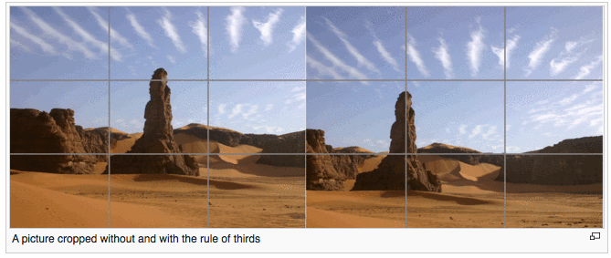
Rule of Thirds
Source: http://en.wikipedia.org/wiki/Rule_of_thirds
Examples: http://digital-photography-school.com/rule-of-thirds/

Slide 31
Take a Picture!
In small groups create a FLICS for…
Outcome: Students should be able to compose a picture by using the Rule of Thirds.
Include
Instructions
Activities
Student Feedback/Evaluation
Notes:
Have groups create a FLIC for composing a photo using rules of third
Outline on whiteboard in whatever format makes the most sense.
10 minutes
2 minutes to present

Slide 32
An example from BCEM 393
Practice questions and quiz
Book and podcast
Discussion board
Online
Instructions
Application
Engagement
Content
Outcome
Assessment
Instructions
Classroom
Feedback
Group
work
Lecture
Notes:
Reminder of example for podcast example next slide

Slide 33

Example Podcast

Slide 34
Creating Videos or Podcasts
Pick a software that you are comfortable using
Free today might not be free tomorrow
Less than 10 minute clips
Keep to a single topic in a short time (Educause, 2012)

Slide 35
What to do with Podcast
Import into D2L
Select “Create file” and “Insert stuff”
Youtube
Vimeo

Slide 36
Using simulations instead of podcasts
http://highered.mheducation.com/olcweb/cgi/pluginpop.cgi?it=swf::100%::100%::/sites/dl/free/0023654666/117354/Ideal_Nav.swf::Ideal%20Gas%20Law%20Simulation
http://forio.com/simulate/mit/cleanstart/simulation/index.html

Slide 37
Technology Strategies
Using technology seamlessly and appropriately
don’t just use it because it is there
Use it more than once
Students might have issues viewing or interacting with content
Avoid barriers
Student accounts (if required reuse it)
Software downloads and/or purchasing
Special computer requirements
Find what is out there
Continuously survey what is available

Slide 38
Examples of Technology
QuickTime screen recording
Snagit
PowerPoint
Adobe Connect Meeting
Camtasia
MS Sway
D2L video note (webcam up to 3 minutes)
Apps
Ted talks
Khan academy
MERLOT

Slide 39
Your Flipped Lesson
Pick a topic or lesson you are familiar with
Start planning a FLICS for that lesson
What is the lesson objective?
What content will you select?
How will the online and class time be connected (Flow)?
How will you assess students?
Create/find a podcast/simulation
For the rest of the morning, work on your flipped lesson. In the last 15 minutes, you will be asked to pair up and share your lesson to get initial feedback.
Notes:
Blank FLICS handout
Or the flipped lesson worksheet

